Slide 1

HOUSING RENTAL APP
Our members-
Aamir
Anushka
Devika
Nikunj
Pratyush
Finding a house for your loved ones is no more a burden. Presenting you our new app “HRA”.

Slide 2

Problem Statement
Housing Rental app deals with giving solution to the people who are in search of home. There are two parties in the app wherein one is the admin who can handle all accounts such as house ,tenants and payments and the other is the buyer.
It deals with
1. Login /Register
2.Manage House / Tenant
3.Manage invoice/Payment
4.View and track Incomplete payments

Slide 3
FLOWCHART
ADMIN
USER
Personal Details –
Full name, phone, email registration, etc.
House Details –
House features, location, facilities, landmark nearby places, etc.
Other features include –
Payments , recent payments, collected payments ,etc.
Payment Details –
Invoice and payment details.

Slide 4
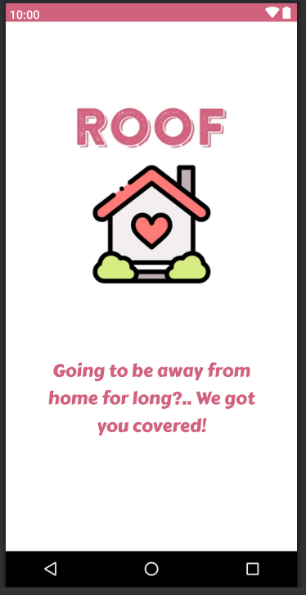
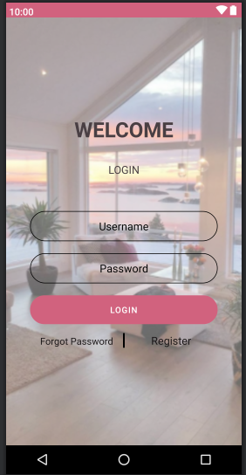
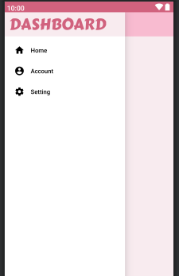
LAYOUTS
LOGIN
DASHBOARD
SPLASH SCREEN

Slide 5
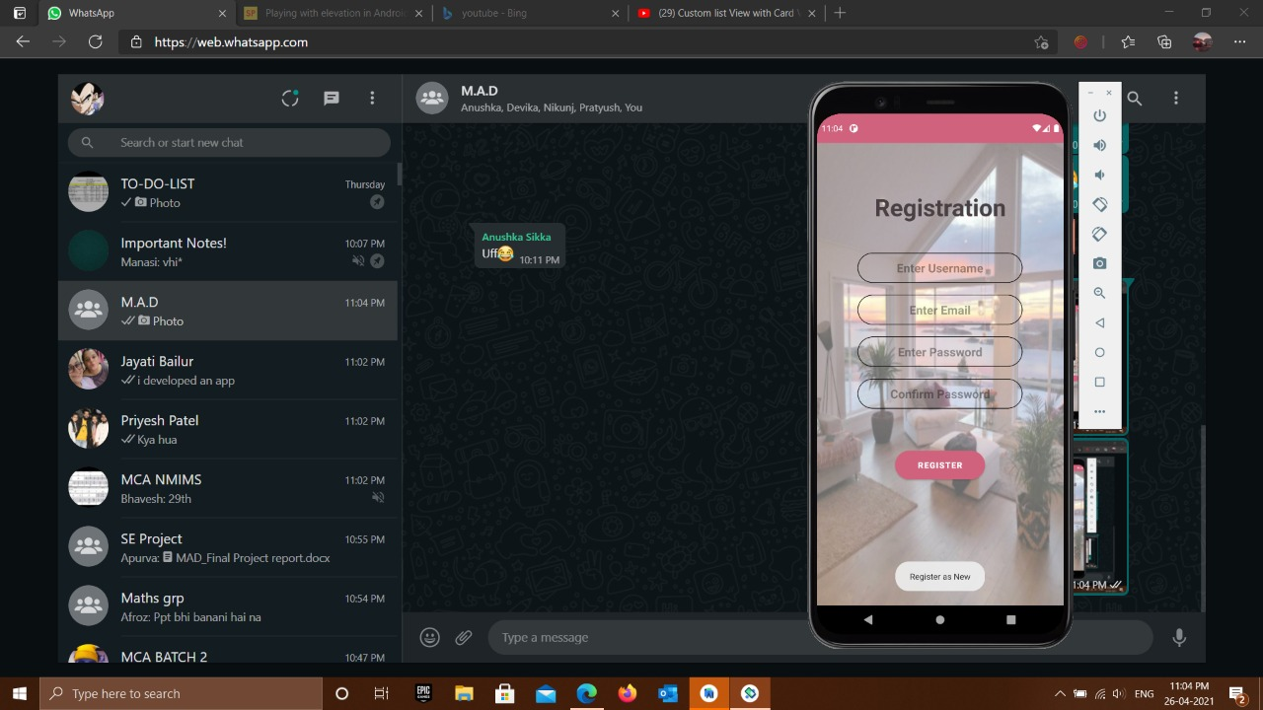
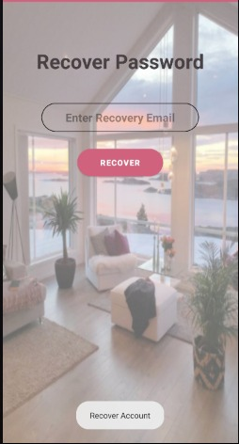
LAYOUTS
FIREBASE
(left picture)Registration screen using firebase.
(Right picture) Password recovery- if forgotten, can be easily recovered as a mail will be sent to the registered email id.
REGISTRATION SCREEN
PASSWORD RECOVERY

Slide 6
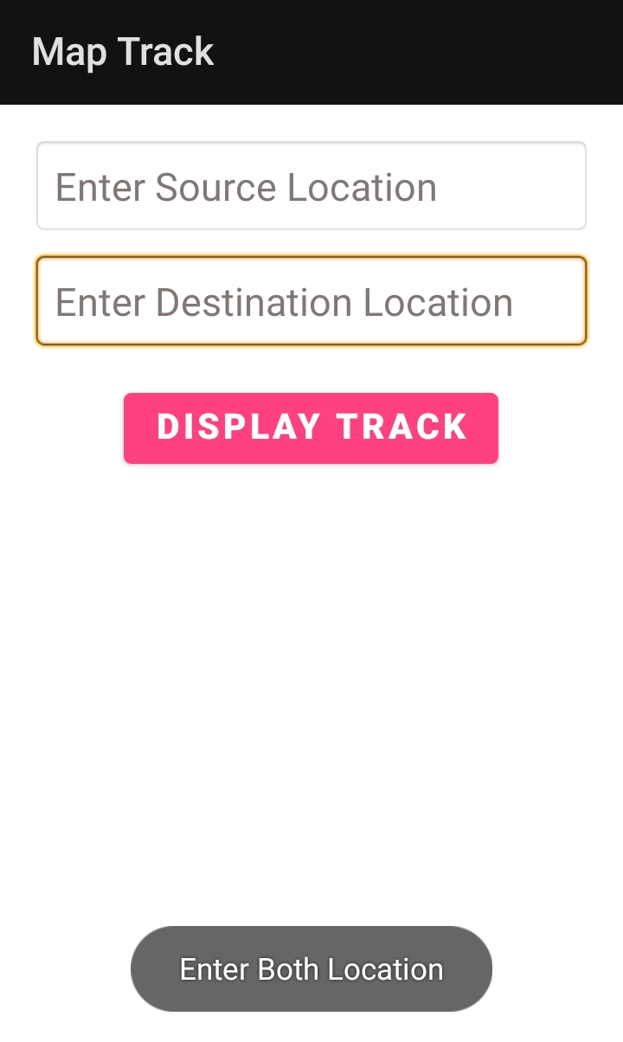
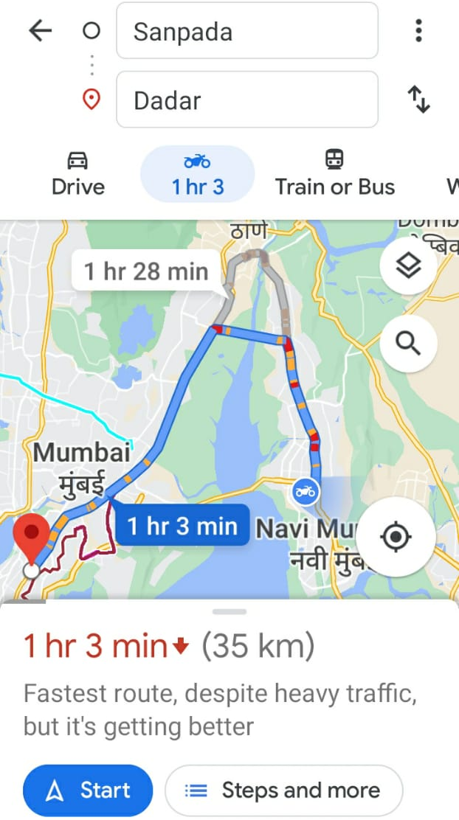
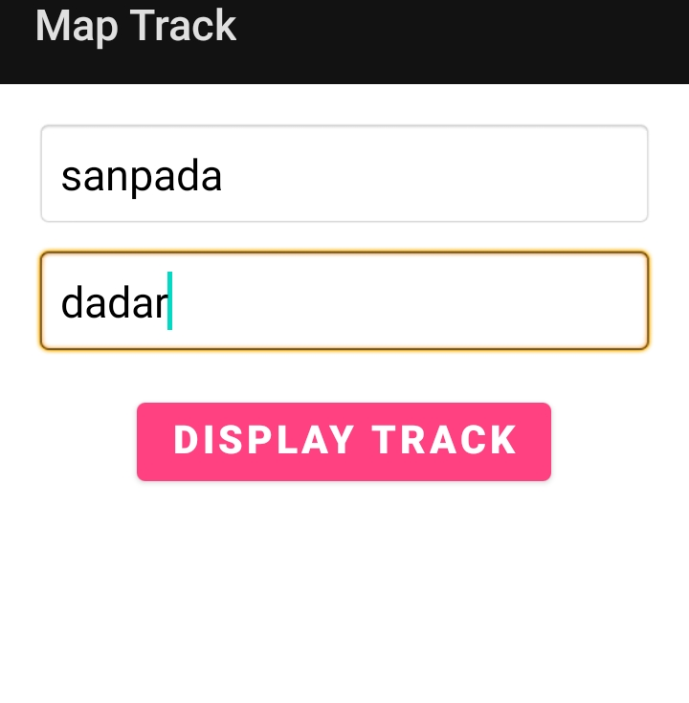
LAYOUTS
MAP TRACK
MAP TRACK

Slide 7
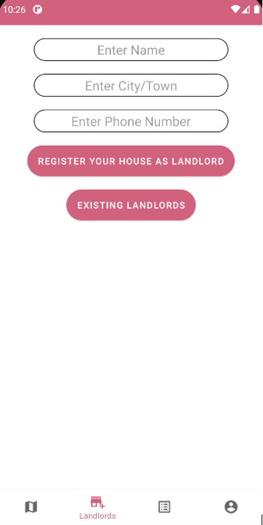
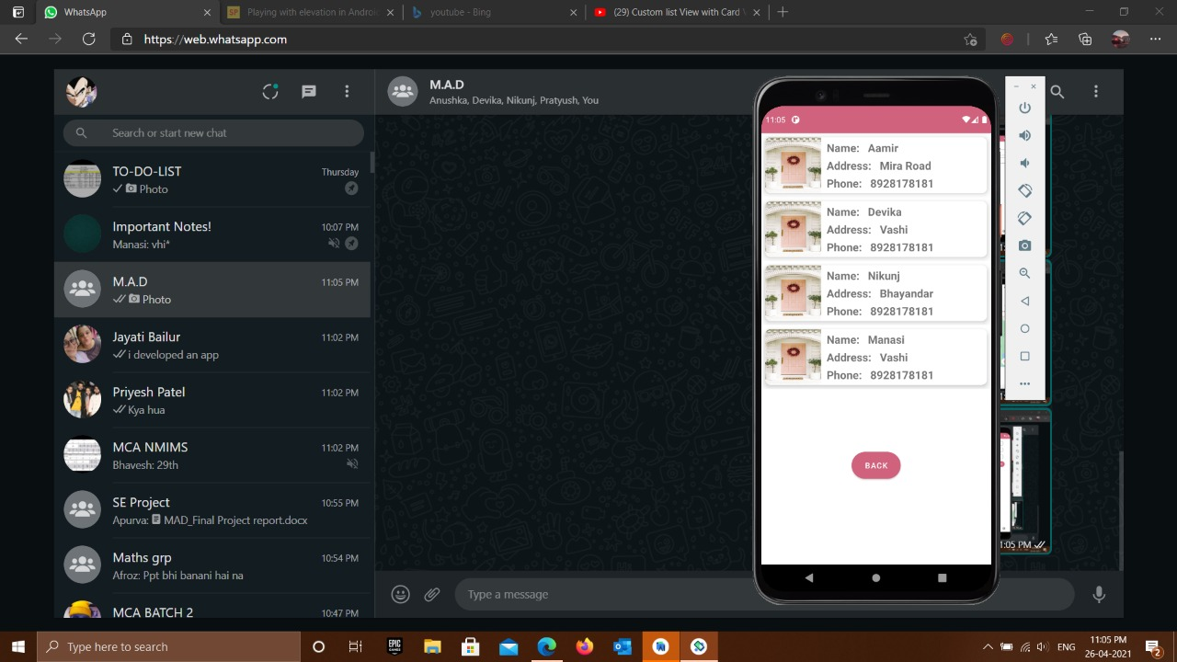
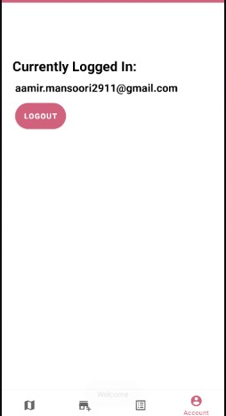
LAYOUTS
CURRENT LOGIN SCREEN
ALREADY REGISTERED LANDLORDS PAGE
LANDLORDS PAGE

Slide 8
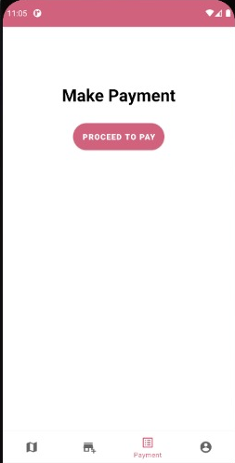
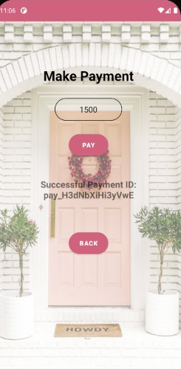
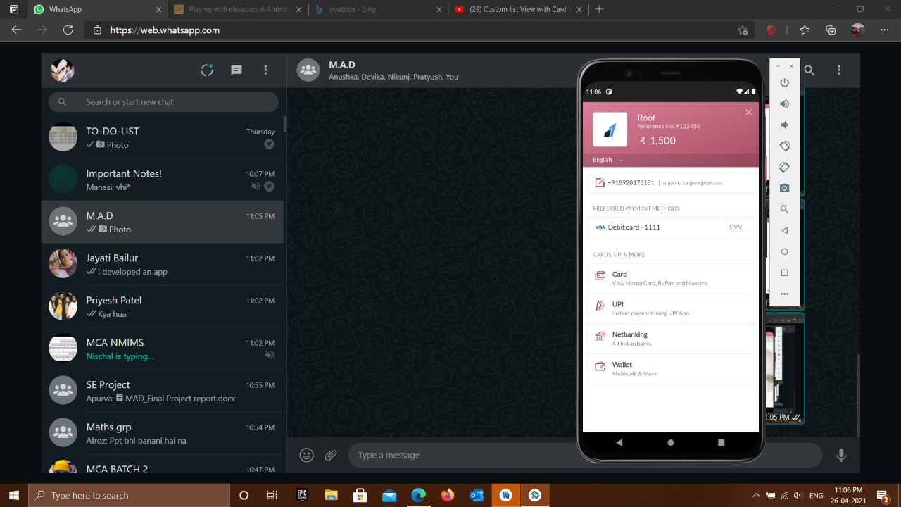
LAYOUTS
MAKE PAYMENT
ENTER AMOUNT
PAYMENT METHOD

